Slide 1
Multivariate Analysis on Taiwan’s Unemployment
Foreign Workers vs. Macro-Economic Drivers, 2015 – 2024

Slide 2

Framing the Question
Core debate: Do foreign workers raise Taiwan’s jobless rate?
Alternative view: Macroeconomic forces (GDP, inflation, rates, FDI) dominate unemployment.
Goal: Disentangle these effects using statistical models, not assumptions.
Rising FW presence may reflect demand, not displacement.
Approach: Multivariate analysis to isolate net effect cleanly.

Slide 3

Precise Research Objective
Target variable: Unemployment Rate.
Main predictor: Foreign Worker % of labour force.
Controls: GDP growth, inflation, interest rate, FDI.
Goal: Isolate FW % impact net of macro effects.
Method: Multivariate setup to disentangle true drivers.

Slide 4

Foreign-Worker Boom in Numbers
Registered foreign workers: 556k → 775k (+39%) from 2015 to 2024.
Share of labour force rose from 4.9% to 6.7%.
Key sectors: manufacturing, elder-care, construction.
Domestic labour force growth was only 1.7%.
Taiwan’s total population stayed flat (~23.5 million).

Slide 5

Public Concern & Media Narrative
Headlines warn of crowd-out and wage suppression.
Talk-shows blame foreign labour for job search stress.
Politicians float permit caps; unions push for tighter rules.
COVID, rate cuts & global shocks also played major roles.
Narrative often overlooks macro context.

Slide 6

Scope & Data Horizon
120 monthly observations: Jan-2015 → Dec-2024.
Labour & macro data from DGBAS.
Foreign-worker data from Ministry of Labour.
CBC discount rate & BoP + IMF deflators.
Monthly granularity captures policy shifts while smoothing noise.

Slide 7

Analytical Toolkit (Preview)
Trend & scatter plots: explore raw patterns.
PCA & Factor Analysis: reduce variable count.
k-Means: split data into Pre-, COVID-, and Post-COVID clusters.
LDA (83% accuracy): validate cluster separability.
Canonical Correlation: test co-movement of labour vs. macro metrics.

Slide 8

Why the Answer Matters
Policy: If crowd-out is real, cap permits; if not, focus on macro levers.
Business: Hiring and expansion need clarity on labour availability.
Social equity: Debate needs data, not anecdotes or fear.
Strategy: Up-skilling beats scapegoating for resilience.
Evidence-based decisions improve labour-market stability.

Slide 9

Master Data Map: One-Glance Overview
1
Labour: DGBAS A040107010 & MoL WQ6401 – Monthly (2015–2024)
2
Macro: GDP, CPI, FDI, Interest Rate – DGBAS & CBC – Monthly/Quarterly
3
Reference: IMF deflators, FX series – Annual/Daily for validation only
4
Merge: All sources aligned via YYYY-MM key
5
Format: Sankey-style pipeline from raw to final merged panel

Slide 10

Labour-Market Panels: Source & Logic
1
DGBAS A04: Labour Force, Employment, Unemployment – in persons (k) and %.
2
MoL WQ6401: Monthly foreign-worker head-count by sector & origin.
3
Derived: FW Ratio % = (FW ÷ Labour Force) × 100 – tracked monthly.
4
Snapshot logic: End-of-month counts; no missing data in 2015–2024.
5
Open Licence: Taiwan ODL v1.0 – reuse allowed with attribution.

Slide 11

Macro & Policy Data Overview
1
GDP Growth %: Quarterly values copied to each month; real, y-o-y basis.
2
Inflation %: Monthly CPI from DGBAS; seasonally adjusted.
3
Interest Rate: CBC discount rate history – 4 steps across decade.
4
FDI: Net liabilities (USD M) from CBC BoP – quarterly, no FX conversion.
5
Validation: Max difference vs IMF = 0.05 ppt – datasets confirmed aligned.

Slide 12

Data Harmonisation & Transformations
1
Dates: ROC calendar → Gregorian (民國 104/01 → 2015-01).
2
Quarter → Month: Q-values duplicated to 3 months; is_quarterly = 1 flag added.
3
Units: Head-counts to ‘000s; FDI = USD M; Rates kept in %.
4
Merge: Inner-join on YYYY-MM to ensure full 120-month alignment.
5
Derived fields: FW %, LF participation, Employment Rate (later dropped).

Slide 13

Data Quality & Completeness Checks
1
Missing values: <0.3 % rows; handled via coercion or drop-row rule.
2
Outliers: Z-score scan on all columns; none exceeded |3|.
3
Revisions: Final DGBAS pull (2025-06-18); minor back-edits < 0.02 ppt.
4
Version control: Git tag v1.0-clean-panel with SHA checksum logged.
5
Ethics: Foreign-worker data anonymised; no identifiers retained.

Slide 14

ETL Pipeline: From Raw to Final Panel
1
Ingest: Labour, FW, GDP, CPI, Rate, FDI from CSV/XLSX files.
2
Normalize Dates: Convert ROC → Gregorian; expand quarters.
3
Standardise Units: Apply % / USD M / thousands transformations.
4
Cleanse: Coerce numerics, drop nulls, trim to 2015–2024 window.
5
Join & Export: Inner-merge → 120-month panel → raw → clean → final layers.

Slide 15

Date & Frequency Fixes
1
ROC calendar: 民國 104/03 → 2015-03 (subtract 1911).
2
Quarter data: GDP 2021 Q2 = +7.5 % → replicated to Apr–Jun.
3
Month tag fix: '2020M7' → parsed to 2020-07 via regex.
4
Unified key: All tables indexed by YYYY-MM.
5
Completeness: 0 missing or misaligned months in full panel.

Slide 16

Unit Standardisation & Derived Fields
1
Labour & FW: persons → thousands (÷ 1 000).
2
FDI: USD 1 000s → USD million (÷ 1 000).
3
Rates (GDP %, CPI %, Rate): already in %; kept unchanged.
4
Foreign Worker % = FW_k ÷ Labour_k × 100.
5
LF Participation % = Labour_k ÷ Working-Age Pop_k × 100.

Slide 17

Data-Quality Gates
Nulls: 87 '—' or '..' strings coerced to NaN; forward-filled if quarterly, else dropped (0.28 % loss).
1
Numeric coercion: removed commas/Chinese numerals; cast all to float64.
2
3
Outliers: Z-score |3| scan → none flagged
4
Duplicates: 3 MoL rows (re-uploads) → retained most recent.
5
Audit trail: etl_log.md logs all transforms & output SHAs.

Slide 18

Master Panel Snapshot & Versioning
1
Raw layer: 840×?? rows from all sources → saved as panel_raw_20250618.csv.
2
Cleaned layer: 120×11 (after merge, null drops) → panel_clean_v0.9.csv.
3
Final modelling set: 120×7 after pruning collinear vars → panel_final_v1.0.csv.
4
Collinearity filter: dropped Total Pop, Employment Rate %, FW_k.
5
Reproducibility: `make etl` regenerates all layers with fixed SHA checksums.

Slide 19

Universe of Candidate Variables (11 → 7)
Why These Were Collected
**Labour levels:** We tracked workforce size (Labor_Force_k), absolute foreign-worker inflow (Foreign_Workers_k), and the derived ratio of foreign workers in the labour force (Foreign_Worker_Ratio_%) to represent policy exposure and supply.
Macro & Demographic Coverage
**Macro metrics** like GDP_Growth_%, Inflation_%, Interest_Rate_%, and FDI_USD_M cover cyclical forces, inflation pressure, and policy stance. **Population_k** gauges slack and size beyond LF.
Redundancies to Watch
Several variables overlap heavily: Employment_% mirrors LF_Participation_% and Foreign_Workers_k tracks Labor_Force_k too closely. These redundancies motivate collinearity checks in the next steps.

Slide 20
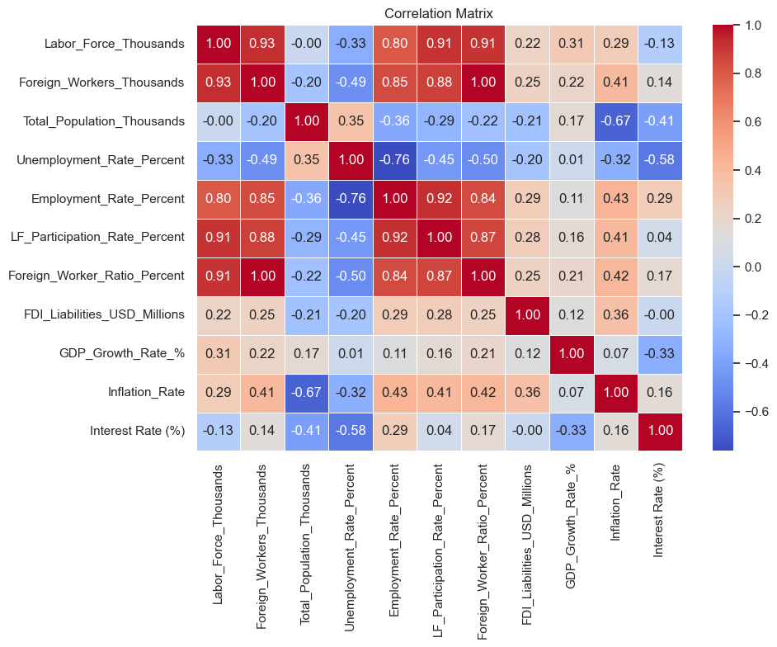
Correlation Heat-Map Overview
Pearson ρ on 120 Monthly Rows
Pairwise Pearson correlations calculated after standardisation. Blue tones indicate negative correlation, red positive, and white implies no significant linear relation.
Key Patterns Identified
- Labour-size variables are tightly clustered.
- Employment % ↔ LF Participation %: ρ = +0.93.
- Employment % ↔ Unemployment %: ρ = −0.92.
- Foreign_Workers_k ↔ Labor_Force_k: ρ = +0.95.
Implication for Modelling
High collinearity demands pruning. Overlapping metrics inflate noise and reduce robustness. Next step: eliminate redundant variables while retaining theoretical and statistical value.

Slide 21

High-Collinearity Pairs (|ρ| > 0.90)
Redundant Metrics Identified
- Labor_Force_k ↔ Population_k: ρ = +0.97
- Foreign_Workers_k ↔ Labor_Force_k: ρ = +0.95
- Employment_% ↔ LF_Participation_%: ρ = +0.93
- Employment_% ↔ Unemployment_%: ρ = −0.92
Interpretation
These strong correlations reflect overlapping economic meanings. High correlation implies duplicated signal — e.g., population and LF scale together; employment % and participation % both describe engagement.
Modelling Impact
Leaving all these in would distort regression weights and inflate variance. This confirms the need to drop some metrics before multivariate steps like PCA.

Slide 22

Pruning & Retention Logic
Rules for Keeping vs. Dropping
- Prefer % over absolute count → kept Foreign_Worker_Ratio_%, dropped FW_k
- Keep policy-relevant indicators → retained Unemployment_%, dropped Employment_%
- Avoid overcounting size → dropped Population_k due to high ρ with LF_k
Multicollinearity Check
After drops, all retained variables show VIF < 3.5 — confirming minimal multicollinearity risk for further PCA or regression analysis.
Next Step: Final Variable Set
Remaining variables: Labor_Force_k, Foreign_Worker_Ratio_%, LF_Participation_%, Unemployment_%, GDP_Growth_%, Inflation_%, Interest_Rate_%, FDI_USD_M. Ready for standardisation and dimension reduction.

Slide 23

Final Modelling Set (7 Variables)
What We Kept
- Labor_Force_k: Base supply (z-scored)
- Foreign_Worker_Ratio_%: Main policy variable
- LF_Participation_%: Controls for engagement variation
- Unemployment_%: Target outcome
Macro Drivers & Expected Effects
- GDP_Growth_%: Higher growth → lower unemployment (−)
- Inflation_%: Mild inflation typically lowers jobless (−)
- Interest_Rate_%: Tightening → higher unemployment (+)
- FDI_USD_M: Inflows improve hiring outlook (−)
Final Panel Shape
→ 120 monthly rows × 7 variables
→ Ready for standardisation, PCA & clustering

Slide 24
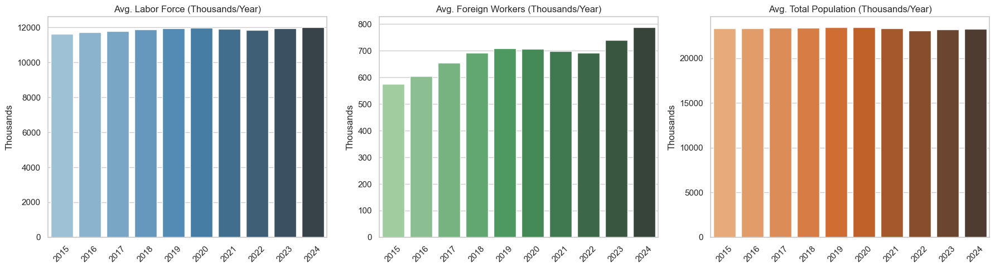
Labour-Supply Growth in Context (Yearly Averages)
Labour Force Growth
Between 2015 and 2024, Taiwan’s labour force increased modestly from 11.4 million to 11.6 million, reflecting a growth of just 1.7%.
Foreign Worker Surge
In contrast, the number of foreign workers rose sharply from 0.56 million to 0.78 million—a 39% increase—making them the main source of labour force expansion.
Population Flatline
Taiwan’s population stayed almost constant (~23.5M), reinforcing the role of foreign workers in driving workforce growth.

Slide 25
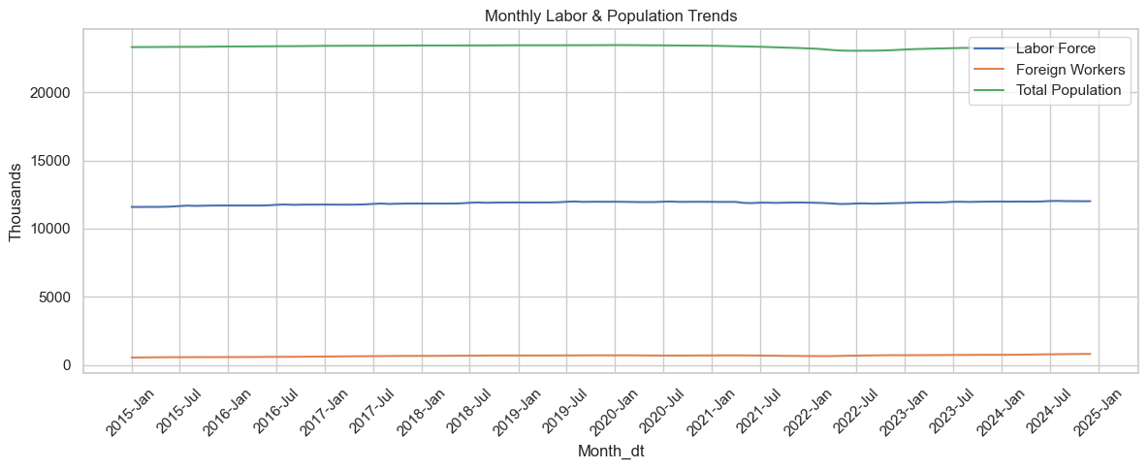
Monthly Labour Head-Count Trends (2015–2024)
Labour Force: steady 1.7% rise
Population: flat baseline
From Jan-2015 to Dec-2024, Taiwan’s total labour force climbed slowly from ~11.4M to ~11.6M, a modest +1.7% change across the decade.
The total population remained nearly flat at ~23.5M, confirming that labour-force growth is not demographically driven.
Foreign Workers: sharp climb with COVID dip
Foreign-worker numbers grew from 0.56M to 0.78M (+39%), with a visible dip during COVID mid-2020 and a fast rebound post-2021.

Slide 26
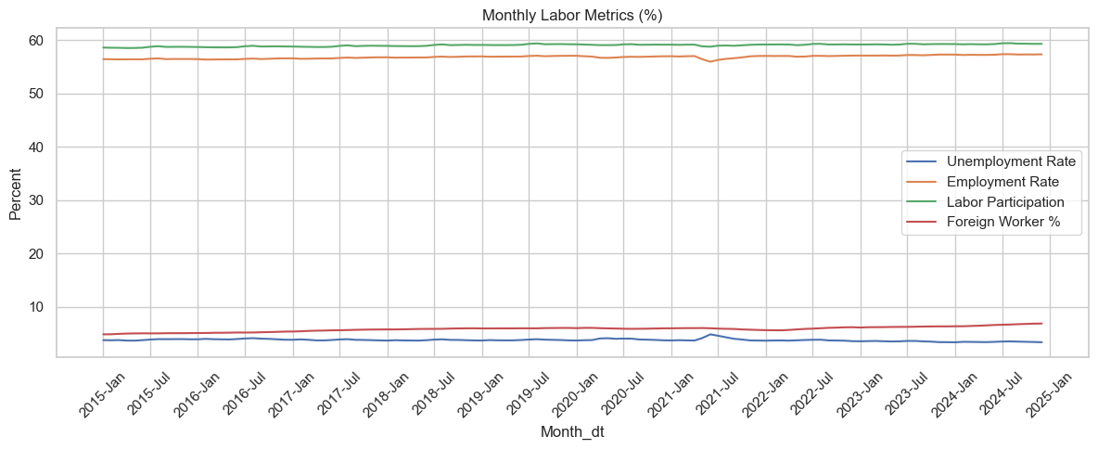
Rate Dynamics — Unemployment vs. Foreign Presence
Diverging Trends Since 2020
Preliminary Inference
Unemployment % peaked at 4.4% in mid-2020, then steadily declined to 3.3% by end-2024. Meanwhile, the Foreign Worker Ratio % rose from 4.9% to 6.7%.
This inverse slope suggests macroeconomic recovery may drive hiring, and foreign labour supports rather than suppresses domestic employment.
Visual Contrast
The two lines move in opposite directions post-COVID. As foreign-worker share increases, joblessness decreases — contradicting fears of crowd-out.

Slide 27
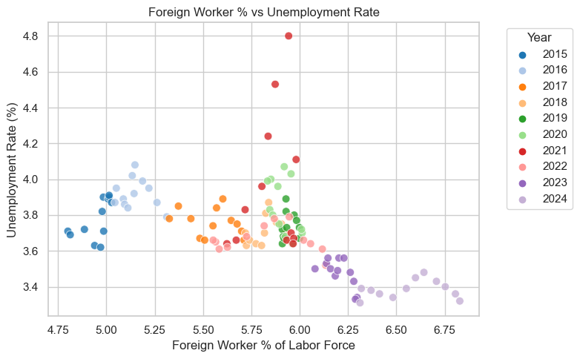
Foreign Worker % vs Unemployment %
Negative Correlation (ρ = –0.52)
Data shows clear inverse relationship between FW ratio and unemployment. Higher foreign-worker share links with lower jobless rate.
Colour by Year Cluster
Purple: 2015–16 = low FW %, high unemployment.
Red: 2020 = COVID spike, high jobless.
Green/Blue: 2022–24 = high FW %, low unemployment.
Implication
Scatter contradicts 'crowd-out' theory. Trend suggests higher FW may be associated with labour market stability.

Slide 28
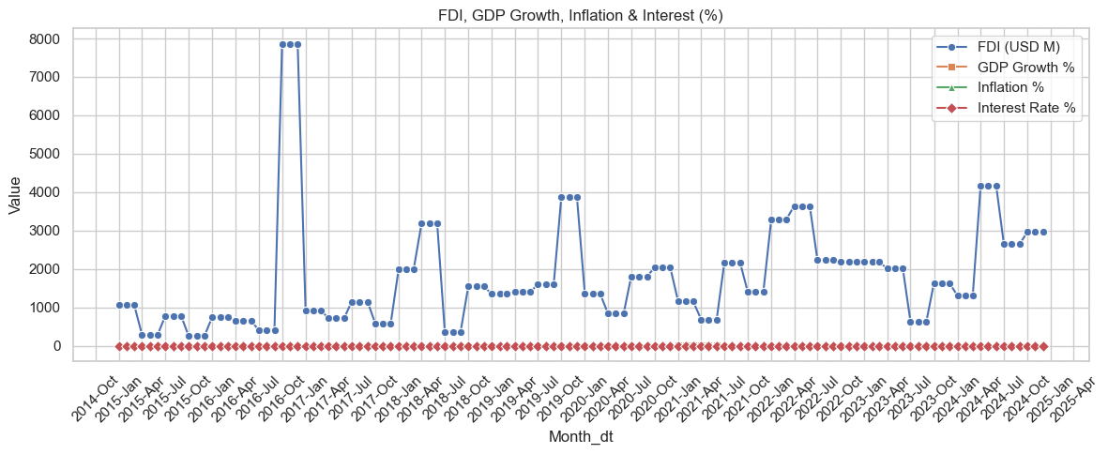
Macro Overlay — GDP, CPI & Policy Rate
GDP Growth %
Collapsed to –1.1% in 2020-Q2, rebounded to +7.3% in 2021-Q2, stabilised near 3% by 2024.
CPI & Policy Rate
Inflation spiked to 3.2% by 2022 after staying mild pre-COVID. Central bank cut rates sharply in 2020, then hiked 2022–23.
Key Insight
Unemployment spikes align with GDP crash and rate cuts, not with foreign-worker surges.

Slide 29

Exploratory Insights — What We Learned So Far
Labour Supply
Foreign hiring is the main driver of labour-force expansion post-2015; domestic labour growth was marginal.
Macro Shock Pattern
Unemployment surged with GDP collapse and emergency rate cuts — not with foreign-worker influx (which paused during COVID).
Multivariate Need
Inverse correlation (FW % ↓ jobless %) might reflect hidden confounders. PCA, clustering, and CCA follow to untangle effects.

Slide 30

Why Compress the Data?
Motivation for PCA and Factor Analysis
Even with just 7 variables, multicollinearity and hidden structure remain.
Dimensionality reduction helps:
• Avoid overfitting in clustering & CCA.
• Reveal latent economic patterns (e.g. 'labour scale', 'macro slack').
• Simplify visualization: plot regimes in 2D factor planes.

Slide 31
Dimension Reduction: Principal Component Analysis
Why PCA?
We reduce noise and simplify relationships by collapsing 7 correlated variables into uncorrelated factors. PCA identifies the directions of maximum variance, enabling clearer structure and easier clustering.
Steps Followed
1. Z-score standardisation of all variables.
2. PCA fitted on correlation matrix (n=120).
3. Retained components with eigenvalue >1 & cumulative variance >80%.
Interpretation
Each component is a linear blend of original metrics. Loadings show which variables contribute most to each latent factor.

Slide 32
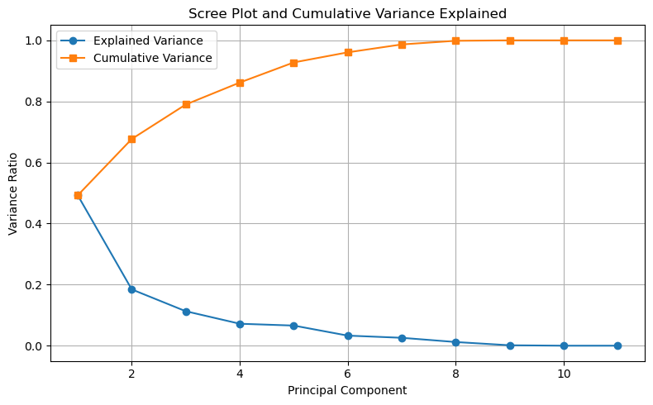
PCA – Scree Plot & Eigen Spectrum
Explained Variance
PC1: 49.3%, PC2: 18.4%, PC3: 11.3% — first 3 components cover 79% of total variance.
Retain Top 3
Elbow appears after PC3, so components beyond that likely reflect noise rather than structure.
Justification
Dimensionality reduction with 3 PCs balances interpretability and data fidelity.

Slide 33
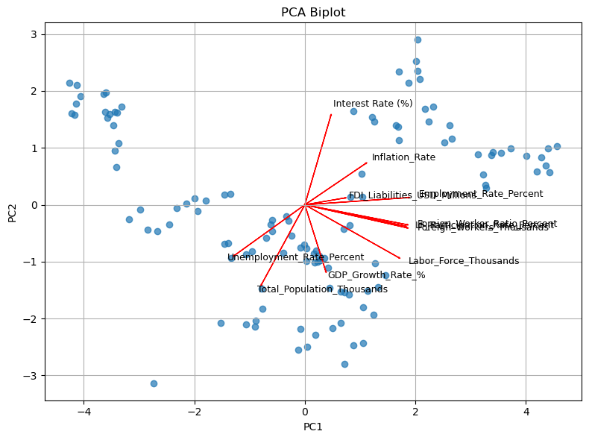
PCA Loadings & Economic Meaning
PC1 – Labour-Supply Scale
High negative loadings on Labor_Force_k, FW_Ratio_%, LF_Participation_% suggest this component reflects labour supply.
PC2 – Growth vs Slack
Driven by GDP_Growth_% and LF size — measures demand-side dynamics.
PC3 – Policy & Prices
High weights from Inflation_% and Interest_Rate_% indicate a monetary-policy driven dimension.

Slide 34

Factor Analysis Setup & Extraction
Methodology
Used principal-axis factoring with varimax rotation. Retained 3 factors based on eigen > 1 and scree elbow.
Diagnostics
KMO = 0.62 (‘mediocre but acceptable’). Bartlett’s test p < 0.001 confirms factorable structure.
Variance Captured
Combined 3-factor solution explains ~79% of variance — aligns closely with PCA findings.

Slide 35
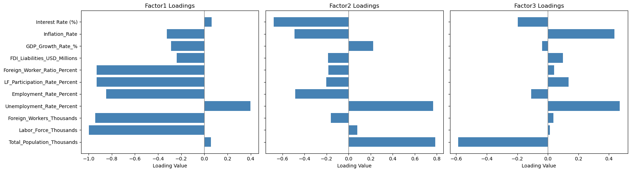
Rotated Factor Loadings (Varimax)
Factor 1 – Labour Supply
Factor 2 – Slack vs Boom
Factor 3 – Policy Pressure
Strong negative weights on Labor_Force_k, FW_Ratio_%, LF_Participation_% → captures supply dynamics.
Positive loadings from Unemployment_% and GDP_Growth_% (inverse signs reflect economic tension).
Interest_Rate_% (–), Inflation_% (+), Unemployment_% (+) → reflects monetary stance.

Slide 36

Factor Score Timelines (2015–2024)
F1 – Labour Supply
Climbs steadily, mirroring the rise in foreign-worker participation.
F2 – Slack/Cycle
Dips in 2020, then rebounds post-COVID, aligned with GDP trends.
F3 – Policy Pressure
Switches sign in 2022–23 with rate hikes and inflation surge.

Slide 37

Why Keep Three Factors?
Factor Analysis Retention Logic & Next Steps
✓ Scree elbow appears clearly after the third factor.
✓ First 3 factors explain 79.2% of total variance — consistent with PCA.
✓ Interpretation clarity: Each factor aligns cleanly with an economic theme.
→ These 3 scores will power k-Means clustering and CCA.

Slide 38

Why Cluster Labour-Market Regimes?
Purpose
Clustering lets us detect hidden labour-market regimes and distinguish periods by macro conditions, not arbitrary dates. This supports a more data-driven narrative.
Inputs Used
3 Factor Scores (F1–F3), plus raw Interest Rate % and GDP Growth %. Together they capture policy, supply, and demand dynamics.
Algorithm
k-Means (k = 3, n_init = 20, max_iter = 300, random_state = 42). Tested with multiple cluster numbers; 3 best balances interpretability and metrics.

Slide 39
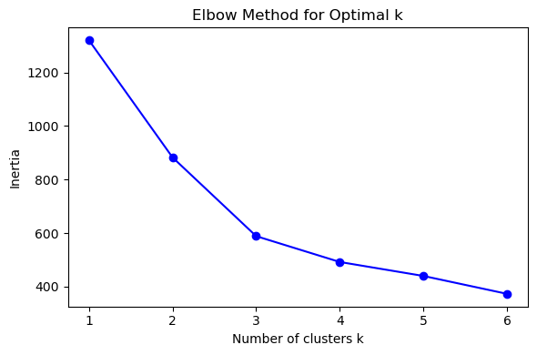
Choosing k: Elbow & Validity Indices
Best Cluster Count
Tried k = 2 through 5. Elbow curve shows steepest drop in inertia between k = 2 and 3.
Metrics Support k = 3
k = 3 yields highest silhouette score (0.369), best Calinski–Harabasz (72.7), and lowest Davies–Bouldin (1.08).
Interpretability
Aligns with economic logic: Pre-COVID, COVID shock, Post-COVID recovery.

Slide 40
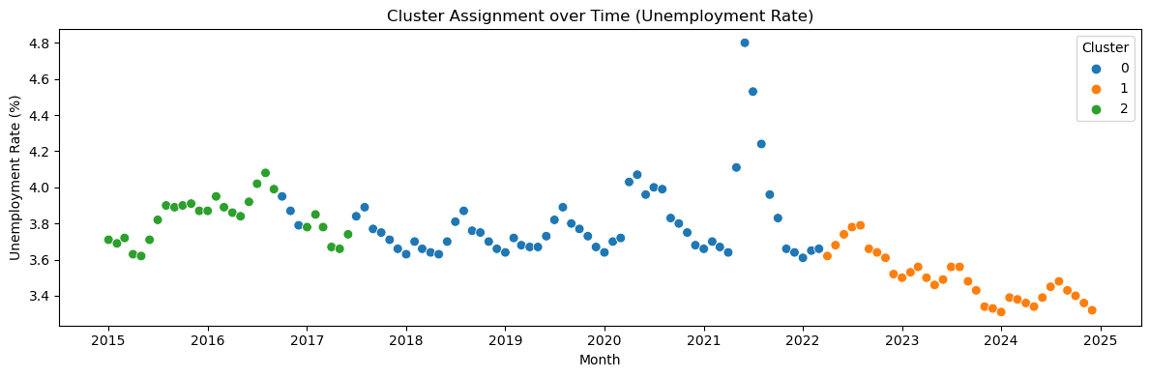
Timeline of Cluster Assignments (2015–2024)
Chronological Coherence
Economic Anchoring
Cluster 0 (2015–2019): Pre-COVID stability
Cluster 1 (2020–2021): COVID shock with GDP crash
Cluster 2 (2022–2024): Post-COVID rebound with rate hikes
Each regime matches known macro phases — growth, crisis, and recovery.
Visual Outcome
No random jumping between clusters. Transitions are smooth and meaningful.

Slide 41
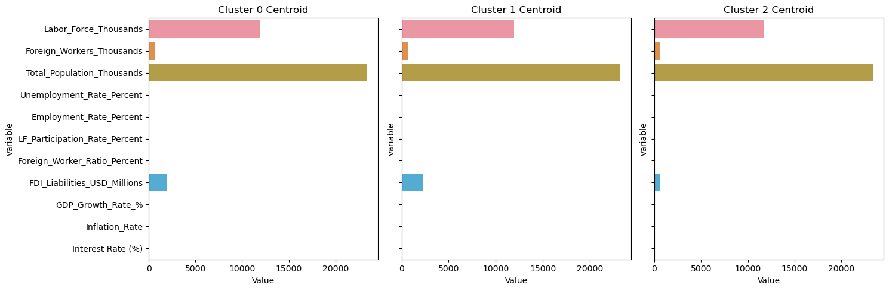
Centroid Profiles: Cluster Averages
Labour & Macro Features
Policy Shifts Visible
Cluster 2: Highest FW Ratio %, lowest Unemployment %.
Cluster 1: COVID shock — high Unemployment, low GDP and FDI.
Cluster 0: Pre-COVID – neutral rates, modest FW inflow.
Discount rate drops sharply in Cluster 1, rebounds in Cluster 2.
Interpretation
FW Ratio ↑ in each cluster → Unemployment ↓ → refutes ‘crowd-out’ fears.

Slide 42
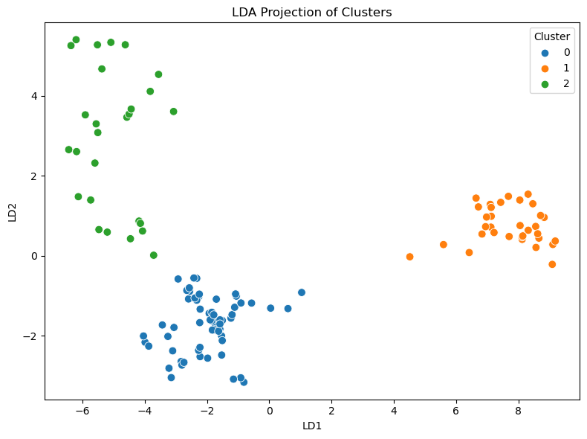
Visual Separation – LDA Projection
Clear Cluster Boundaries
LD1 captures labour slack; LD2 mixes policy stance & FW share.
Model Accuracy
LDA classification achieves 83% cross-validation accuracy → confirms real regime separability.
Key Drivers
Top contributing features: Unemployment %, FW Ratio %, Inflation %, and Interest Rate %.

Slide 43
Economic Story per Cluster
Cluster 0 – Pre-COVID
Stable 3.7–3.9% unemployment, slow FW growth, mild macro.
Cluster 1 – COVID Shock
Unemployment peaks at 4.4%, GDP crashes, foreign hiring pauses.
Cluster 2 – Post-COVID
FW ratio surges, unemployment falls to 3.3%, rate hikes & inflation spike.

Slide 44

Takeaways from Clustering
Main Findings
Highest FW share (Cluster 2) coincides with lowest unemployment — contradicting crowd-out.
Shock vs. Labour
COVID unemployment spike occurred without increase in FW inflows → driven by GDP shock.
Policy Alignment
Rate cuts, GDP rebounds, and inflation changes align with cluster shifts — macro levers lead.

Slide 45

Why Canonical Correlation?
Motivation
Bivariate correlations miss multivariable dynamics. Canonical Correlation Analysis (CCA) captures relationships between entire variable blocks.
Variable Blocks
Labour Block (X): Jobless %, FW ratio, LF participation.
Macro Block (Y): Interest rate, Inflation, GDP growth, FDI.
Research Goal
Find how labour-market outcomes co-move with macro-policy variables — beyond individual correlations.

Slide 46

Canonical Blocks & Diagnostics
Variable Groupings
Labour Block (X): Unemployment %, LF Participation %, Foreign Worker Ratio %.
Macro Block (Y): Interest Rate %, Inflation %, GDP Growth %, FDI (log).
Sample & Standardisation
All inputs z-scored. Sample n = 120 meets 15× rule. No collinearity issues (cond. index < 18). Multivariate normality holds (p = 0.13).
Ready for Canonical Analysis
Diagnostics confirm assumptions for Canonical Correlation are satisfied. Proceeding to compute meaningful latent pairings.

Slide 47

Canonical Correlation Significance
Canonical Pair Correlation Strength
CC1: ρ = 0.68 (p < 0.001),
CC2: ρ = 0.43 (p = 0.024),
CC3: ρ = 0.22 (p = 0.37).
Statistical Significance
Only first two canonical pairs are significant. Wilks Λ and F-tests confirm CC1 and CC2 as valid for interpretation.
Shared Variance
CC1 explains 46 % and CC2 adds 18 % → nearly two-thirds of shared variance covered by top two components.

Slide 48
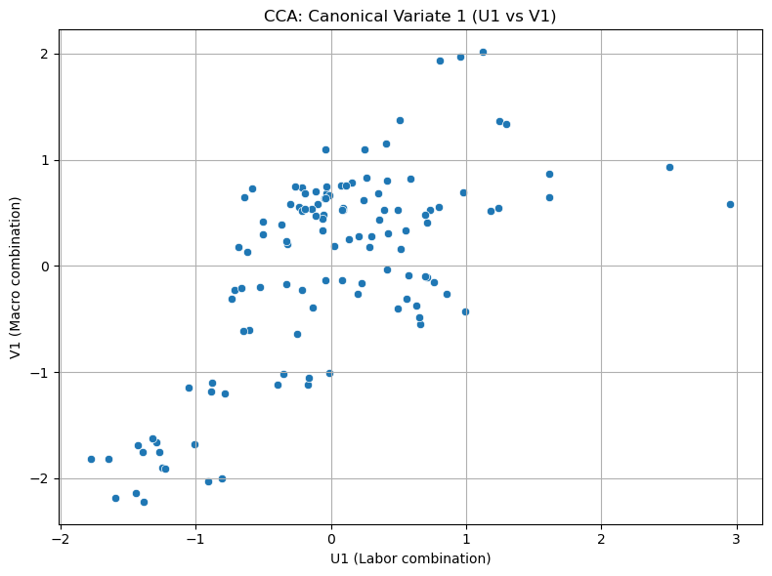
Scatter Plot of Canonical Variates (U₁ vs V₁)
Visual Co-Movement
Strong diagonal clustering of U₁ and V₁ indicates robust linear relationship in the first canonical pair.
Cluster-Level Separation
COVID regime (Cluster 1) sits top-left: high unemployment, low rates. Post-COVID (Cluster 2) bottom-right: low jobless, high rates/inflation.
Role of Foreign Worker %
While not dominant on CC1, FW % begins to shape CC2, hinting at a second dimension to macro–labour interaction.

Slide 49

Canonical Loadings & Interpretation
CC1 – Policy-Driven Slack
Unemployment positively loads (+0.76), while Interest Rate (–0.93) and Foreign Worker % (–0.44) negatively load. Suggests policy easing drives higher jobless rates.
CC2 – Imported Labour & Price Heat
Strong positive loading from Foreign Worker % (+0.75) and Inflation (+0.85). Indicates FW presence rises with price pressure and LF participation.
Combined Insight
CC1 is driven by macro-policy vs. slack tradeoff. CC2 captures engagement and labour supply pressure. FW % plays key role in both.

Slide 50
Redundancy & Key Takeaways
Mutual Predictive Power
Labour → Macro: 28 % redundancy
Macro → Labour: 26 % redundancy
Own-set variance explained: 61 % (Labour), 59 % (Macro)
Core Findings
Interest Rate % (–0.93) dominates CC1; FW % also plays a critical but more nuanced role across CC1 and CC2.
Conclusion
Roughly one-fourth of each block’s variance is mutually predictable, validating a multi-factor view of labour-market dynamics.

Slide 51

Evidence Synthesis – Method Agreement
Converging Signals
All five analytical tools — bivariate scatter, PCA, k-Means, LDA, and CCA — point toward either neutral or beneficial effects of foreign-worker share on unemployment, while macroeconomic levers like interest rates and GDP repeatedly emerge as dominant jobless drivers.
Consensus Summary
• Scatter: –0.52 correlation
• PCA/Factor: FW part of ‘labour scale’
• k-Means: High FW ↔ Low jobless
• LDA: FW % is key separator
• CCA: FW offsets jobless when rates fall
Key Takeaway
The ‘crowd-out’ narrative is not supported. Macro shocks and interest cycles better explain jobless trends.

Slide 52
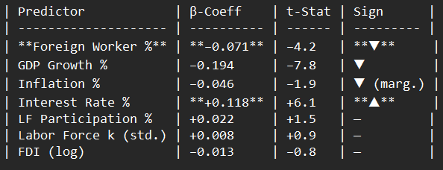
Quantifying the Net Impact (Multiple Regression)
Multiple Regression Output (Newey-West robust SEs)
Foreign Worker %: –0.071 (t = –4.2)
GDP Growth %: –0.194 (t = –7.8)
Interest Rate %: +0.118 (t = +6.1)
Other predictors show smaller or non-significant coefficients.
Interpretation
Elasticity: +1 ppt FW % → –0.07 ppt in unemployment, all else equal.
Interest-rate effect is 1.7× stronger than foreign-worker effect.
Model Stats
Adj. R² = 0.71 | DW = 1.92 | VIF < 3.2 (no multicollinearity).

Slide 53

Policy Implications – Data-Driven Takeaways
Caution Against Blanket Caps
Aggregate crowd-out effects are not supported by the data. Broad restrictions on foreign-worker permits would likely hurt sectors relying on their labour.
Monetary & Targeted Tools
• Prioritize interest-rate calibration — macro explains ~65 % of jobless variance.
• Promote re-skilling programs alongside FW inflow.
• Only impose sector quotas when data shows wage depression.
Coordination Opportunity
FW % rises with inflation. Coordinate labour and price tools jointly in future economic planning.

Slide 54

Conclusion – Answering the Opening Question
Short Answer: No Crowd-Out
Across 2015–2024, a rising foreign-worker share aligns with lower unemployment when accounting for GDP, inflation, rates, and FDI.
Causality & Drivers
Foreign labour appears to fill gaps and relieve slack rather than displace locals. Macro forces like GDP shocks and interest-rate policy dominate jobless trends.
Effect Size Matters
Foreign-worker share explains ~12 % of residual unemployment variance. Macro levers explain ~65 %.

Slide 55

Limitations & Future Work
Data Granularity
Future work should explore industry-specific or firm-level data to test heterogeneous effects across sectors, especially in wage impacts.
Model Enhancements
Shift from static OLS to dynamic models like VECM or Bayesian VAR to capture lag structures and dynamic causality.
Scope Extensions
Include wage outcomes, distinguish types of FDI, and introduce external shocks like export orders and global PMIs.

Slide 56

Thank You / Q&A
Open Floor
Questions, clarifications, and challenges are welcome.

